Slide 1


The Municipal Pension Plan and You
Information for former contract support service workers, returning to health authority employment

Slide 2

Municipal Pension Plan(MPP) – A paycheque for life!
You have worked hard and deserve to have some income security in your older years
After your wages, the pension plan can be the 2nd most valuable asset you earn
MPP is a defined benefit plan – lifetime pension is guaranteed for your life and possibly your family
Unions and people advocating together won the right for a defined benefit pension plan – increasingly rare in Canada

Slide 3
What is the Municipal Pension Plan?
The MPP is one of several public sector pension plans in British Columbia
You join the plan by working for an employer in the MPP
Both you and your employer contribute while you are working

Slide 4
MPP: a dependable benefit
When you retire the Plan guarantees you a monthly payment that you can depend on
It’s secure and worry-free
You retire knowing what your pension income will be

Slide 5
The Pension Formula
Your pension is determined by a formula:
Your service
years & months of pensionable service
Average best 5 years
the average of your 5 best income years (HAS)
1.9%
(beginning Jan 1, 2022)

Slide 6

Contribution rates and benefits
75% of your pension is paid for through investments; the plan has about 68.4 billion in assets and investments with a return of 7.1% (June 2022)
Member contribution rate is 8.61% of paid hours up to 1 FTE (1950 hours)
Employers contribute 9.31% of your paid hours
25 years produces a guaranteed lifetime pension that is about 47.5% of your working income
There is cost of living indexing added and access to extended health & dental benefits

Slide 7

Who is enrolled?
If you were in the Municipal Pension Plan in the past, you will again contribute and build your retirement income
Regular full-time employees are automatically enrolled after 3 months in their first regular position
If you are a regular part-time employee, you will be offered membership in the plan or required to sign a waiver saying you decline. You can join later too.
The formula for Casual status employees is a bit complicated. Casual employees should contact their HEU Representative for more information.
There are over 900 employers in the plan – hospitals, community and home care, many long term care sites, schools, municipalities, and others

Slide 8
Your income as a senior
Federal Government Programs
Pension Programs from Work
Provinicial Government Programs
The Canada Pension Plan (CPP) – the amount is based on the years you and employers contribute and on your working income.
Municipal Pension Plan (MPP) is one of the most valuable retirement assets because it’s stable and secure and it pays a guaranteed monthly income.
Some Provincial Government Programs may aid your retirement, if you qualify. They include: SAFER (rent help), Pharmacare, Seniors’ Supplement, etc.
Old Age Security (OAS) and the Guaranteed Income Supplement (GIS) within it are based on 40 years of Canadian residency after age 18.
The MPP will last for your lifetime, and (if you choose) can be a source of guaranteed income for the lifetime of your spouse.
Savings and Assets
Your individual and/or family savings and assets will contribute to your income.

Slide 9
OAS, GIS, and family savings
OAS
GIS
Savings
The full amount (40 years of official residency): $687.56/month* OAS per month beginning age 65 for a single senior
Smaller amounts are paid if you have between 10 and 40 years
If you have 40 years of official residency:
GIS is paid to seniors with incomes less than $20,832/year* for a single senior.
You and your family’s savings and assets will help - but they can be hard to predict as you age.
Nearly 1/3 of seniors in BC who qualify for OAS receive the GIS
*Check www.canada.ca for the most up-to-date OAS & GIS information, including monthly payments and income thresholds.

Slide 10
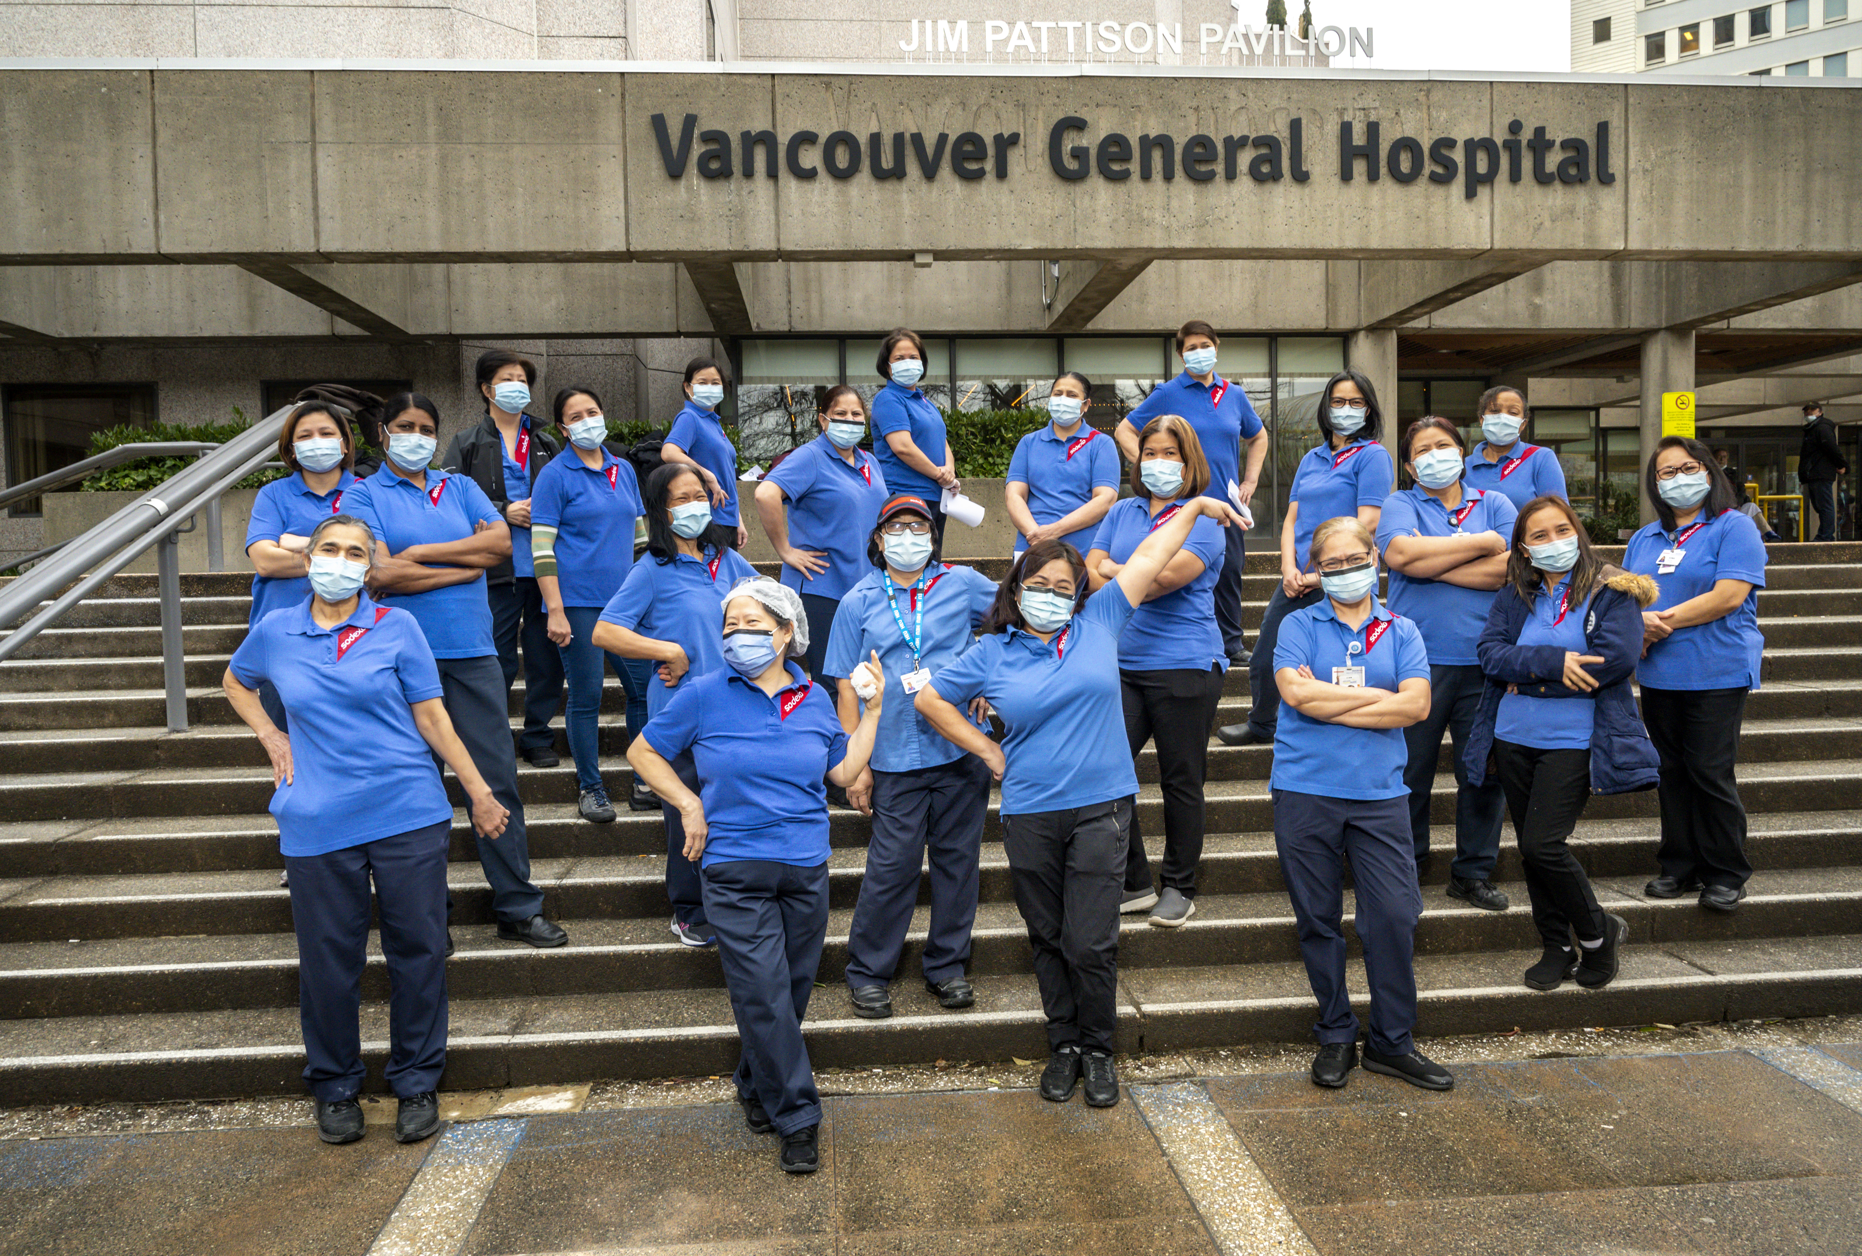
More info on the MPP
Pension Corporation staff can help you find out if you are already a member from past work, and answer your questions.
MPP phone: 1-800-668-6335 (weekdays)
MPP website: mpp.pensionsbc.ca
The MPP website has “My Account” which you can use to determine your pension amounts as you continue working for employer(s) in the MPP.

Slide 11

Thank you!
You can get help from your HEU staff rep at regional or provincial offices at:
Email: heu@heu.org
Phone: 1-800-663-5813

